Slide 1

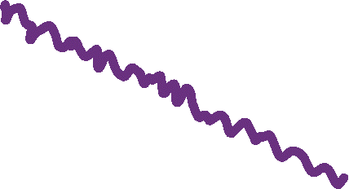


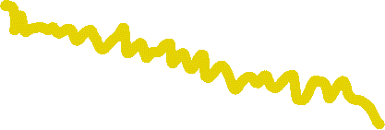


Integrating local and pairwise neural time-series dynamics to study schizophrenia
CNS2022
Presented by:
Annie G. Bryant
School of Physics
The University of Sydney

Slide 2
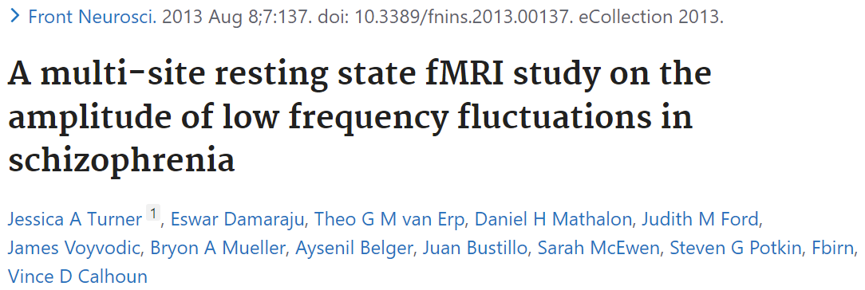
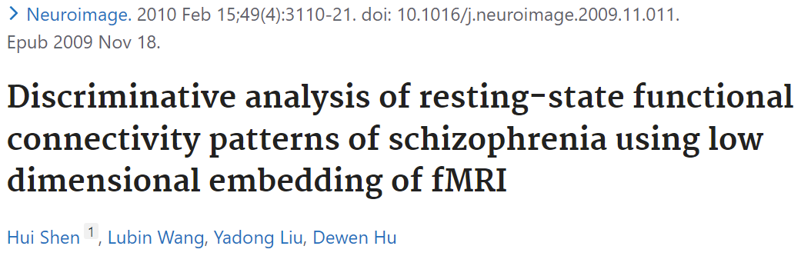
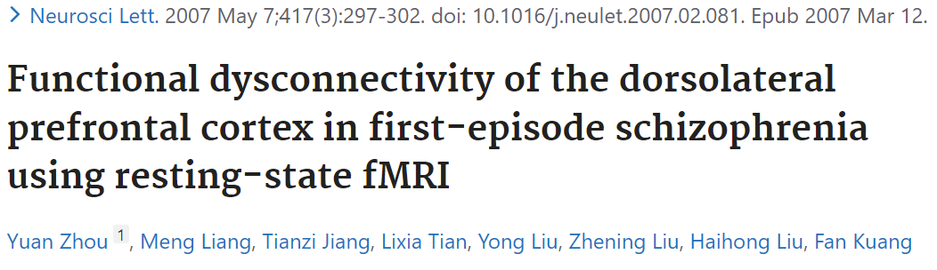
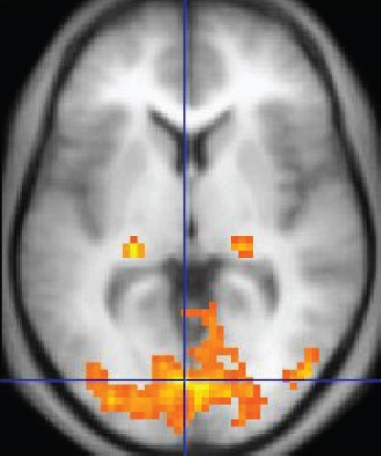
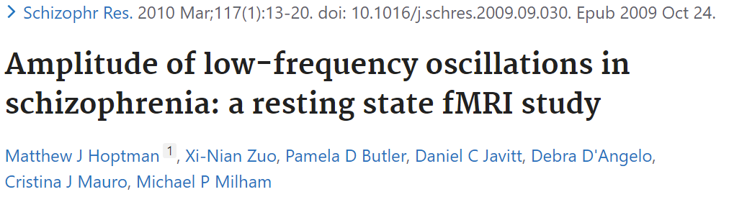
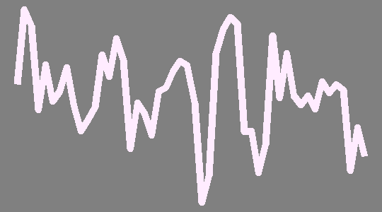

Functional neuroimaging as a tool to understand schizophrenia
Schizophrenia: Pyschiatric disorder that generally presents with delusions, disorganized thinking, hallucinations, and paranoia
Cognitive function deficits linked to altered neural activity in task-based functional neuroimaging¹
Functional magnetic resonance imaging (fMRI) blood oxygen level-dependent signaling (BOLD)
BOLD signal in one voxel
Based on ratio of oxygenated to deoxygenated hemoglobin in the blood
Serves as proxy readout for neuronal activity
¹Karlsgodt, Sun, and Cannon. Curr Dir Psychol Sci (2010)
Notes:
BOLD overview + What makes this a good application for neuroimaging TS analysis

Slide 3
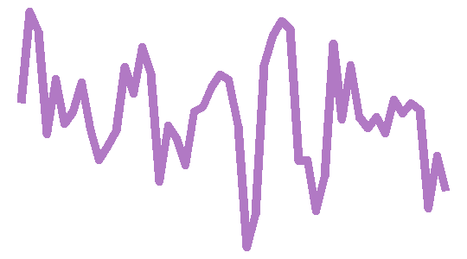
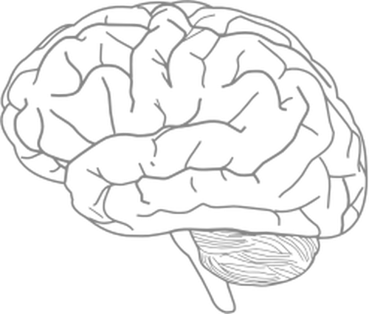
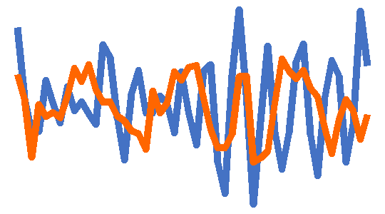
BOLD-measured neural activity represents an interacting system with individual components
Pairwise functional connectivity dynamics
Higher-order interaction networks
Local regional dynamics
Example: fALFF
Example: Pearson correlation coefficient
Example: Node degree within graph network

Slide 4
Current State of the Neuroimaging Subject Classification Union
Pairwise functional connectivity dynamics
Local regional dynamics
OR
Only 1-2 features are selected a priori based on literature standards
Complex classification models may obscure the actual brain region and time-series feature contributions to classification
Example: fALFF
Example: Pearson correlation coefficient

Slide 5
Introducing an integrated approach for the comprehensive evaluation of local and pairwise neural dynamics
Pairwise functional connectivity dynamics
Local regional dynamics
AND
Dozens to hundreds of features derived from interdisciplinary research are evaluated
Goal: combine univariate and multivariate time-series features in a biologically interpretable classification model
Example: fALFF
Example: Pearson correlation coefficient

Slide 6

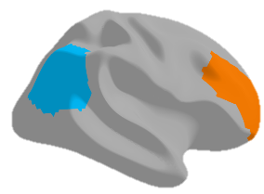
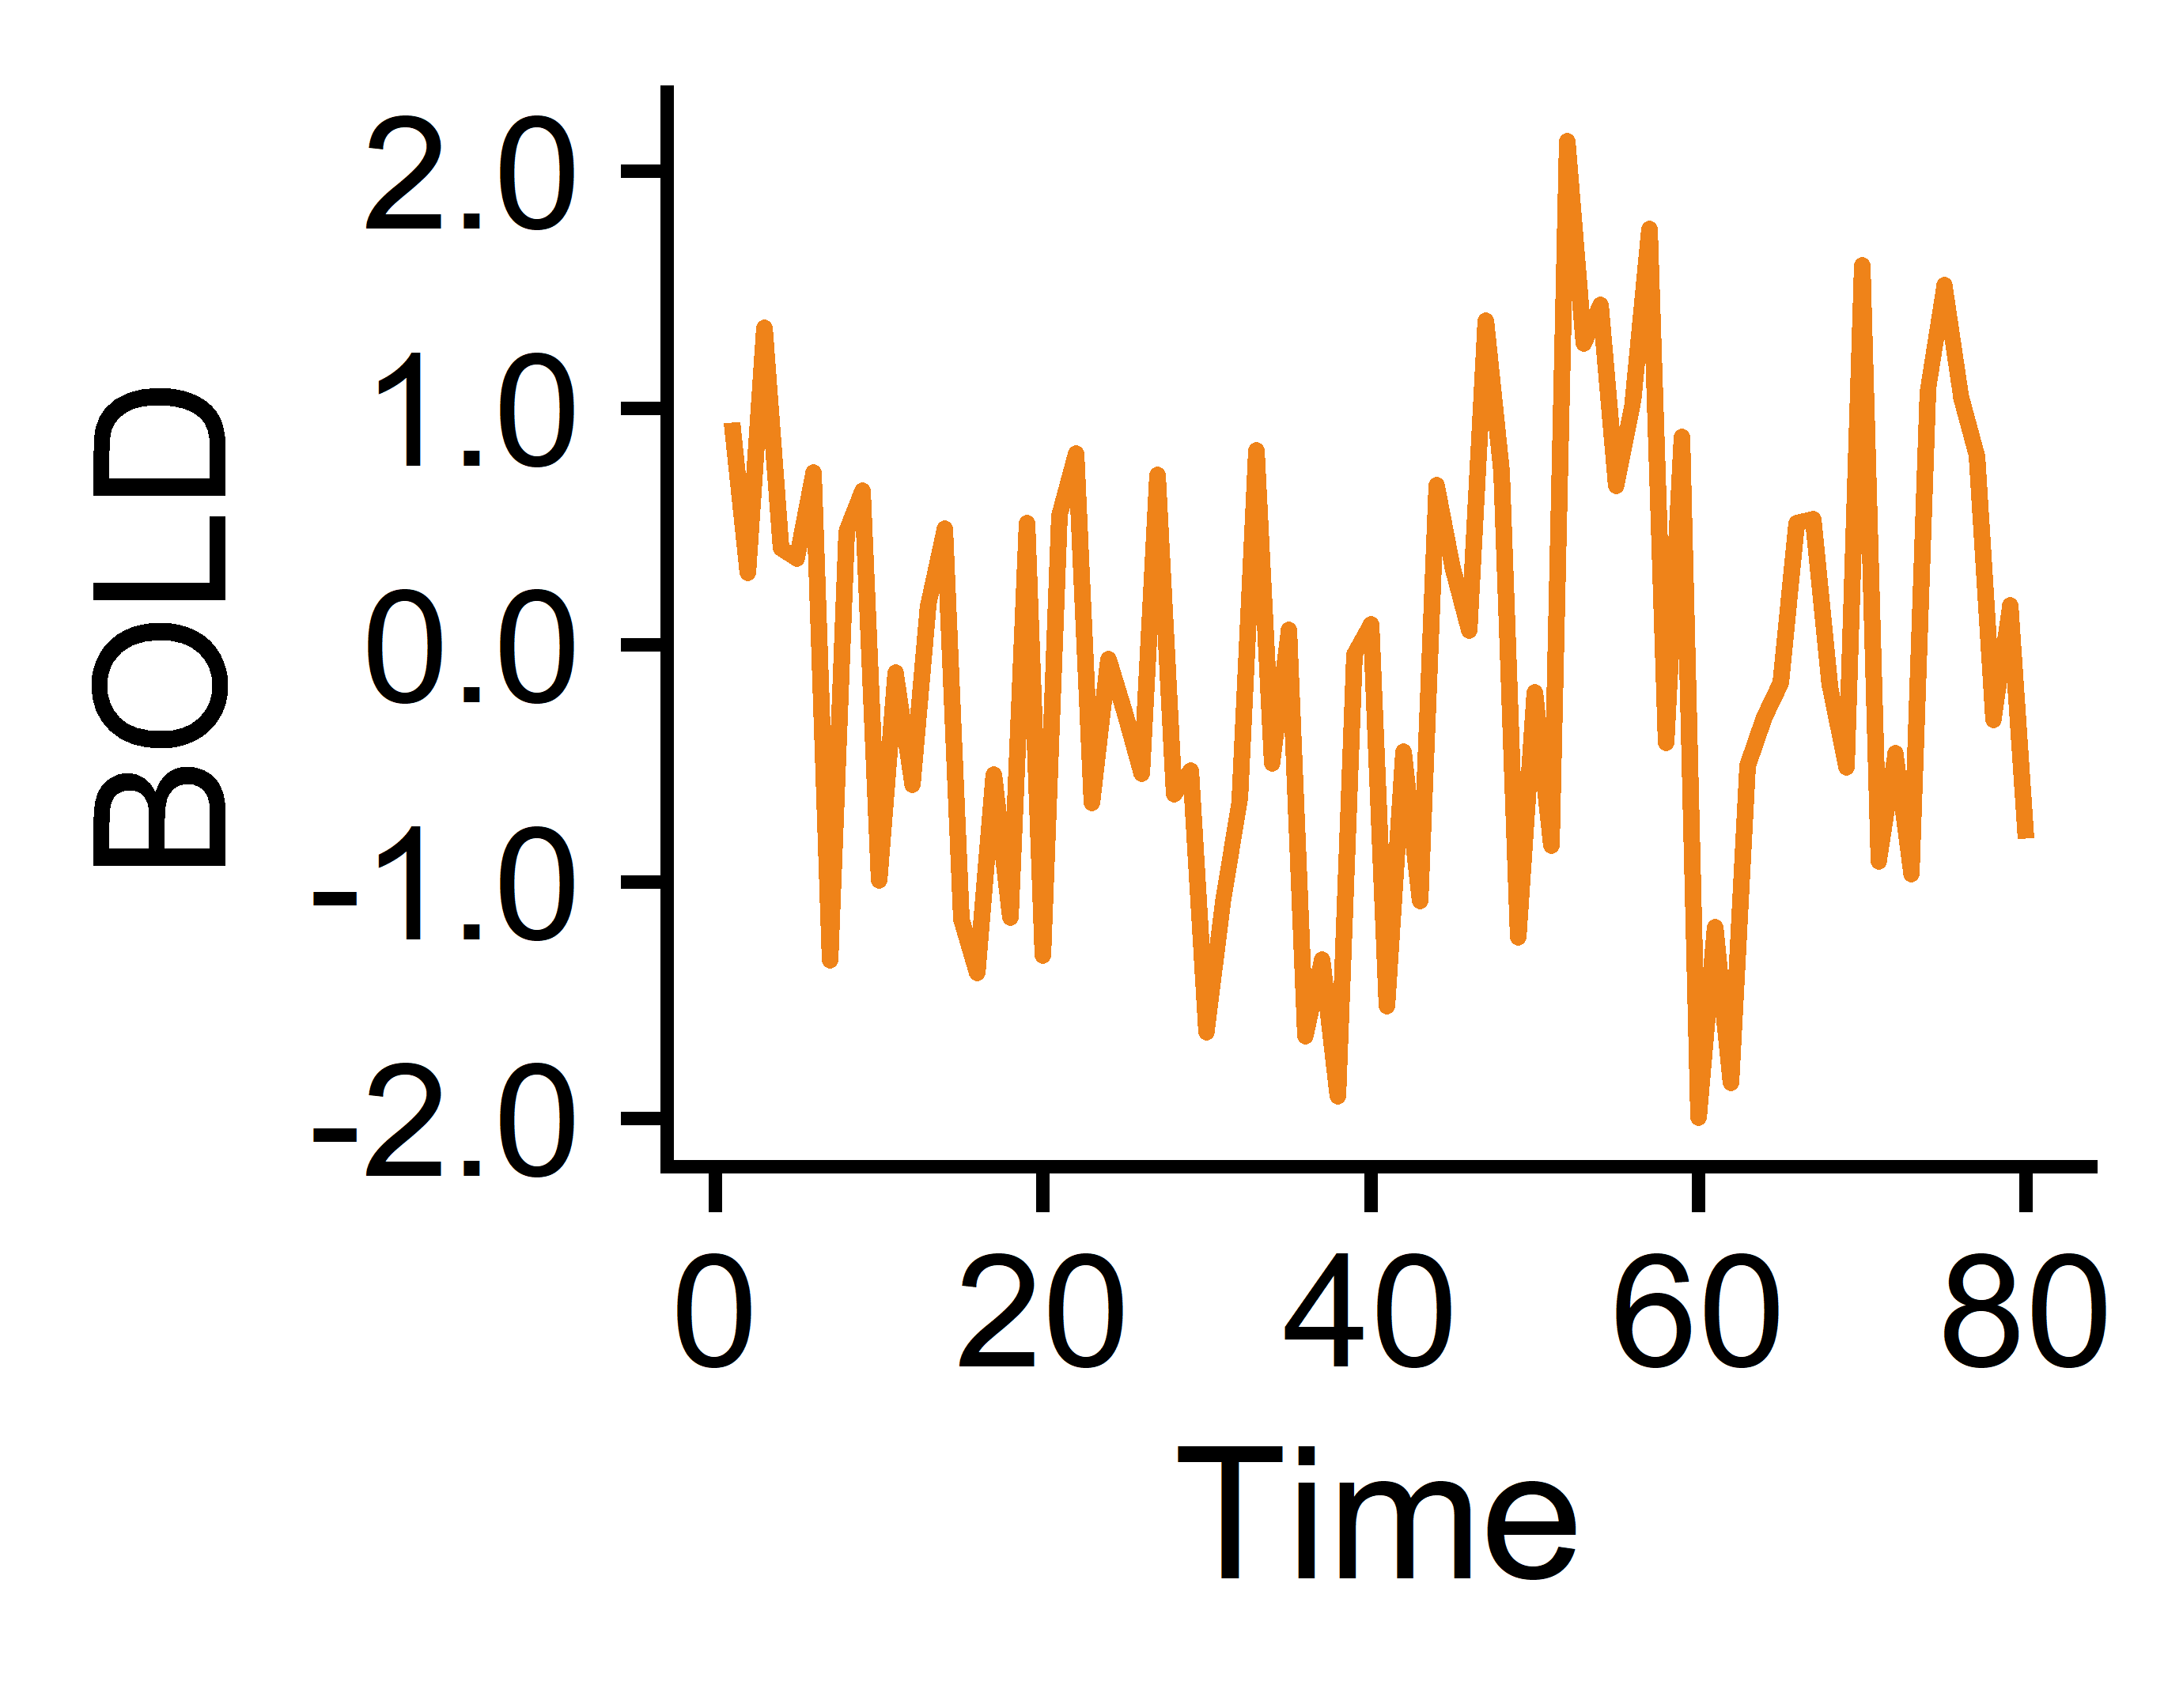
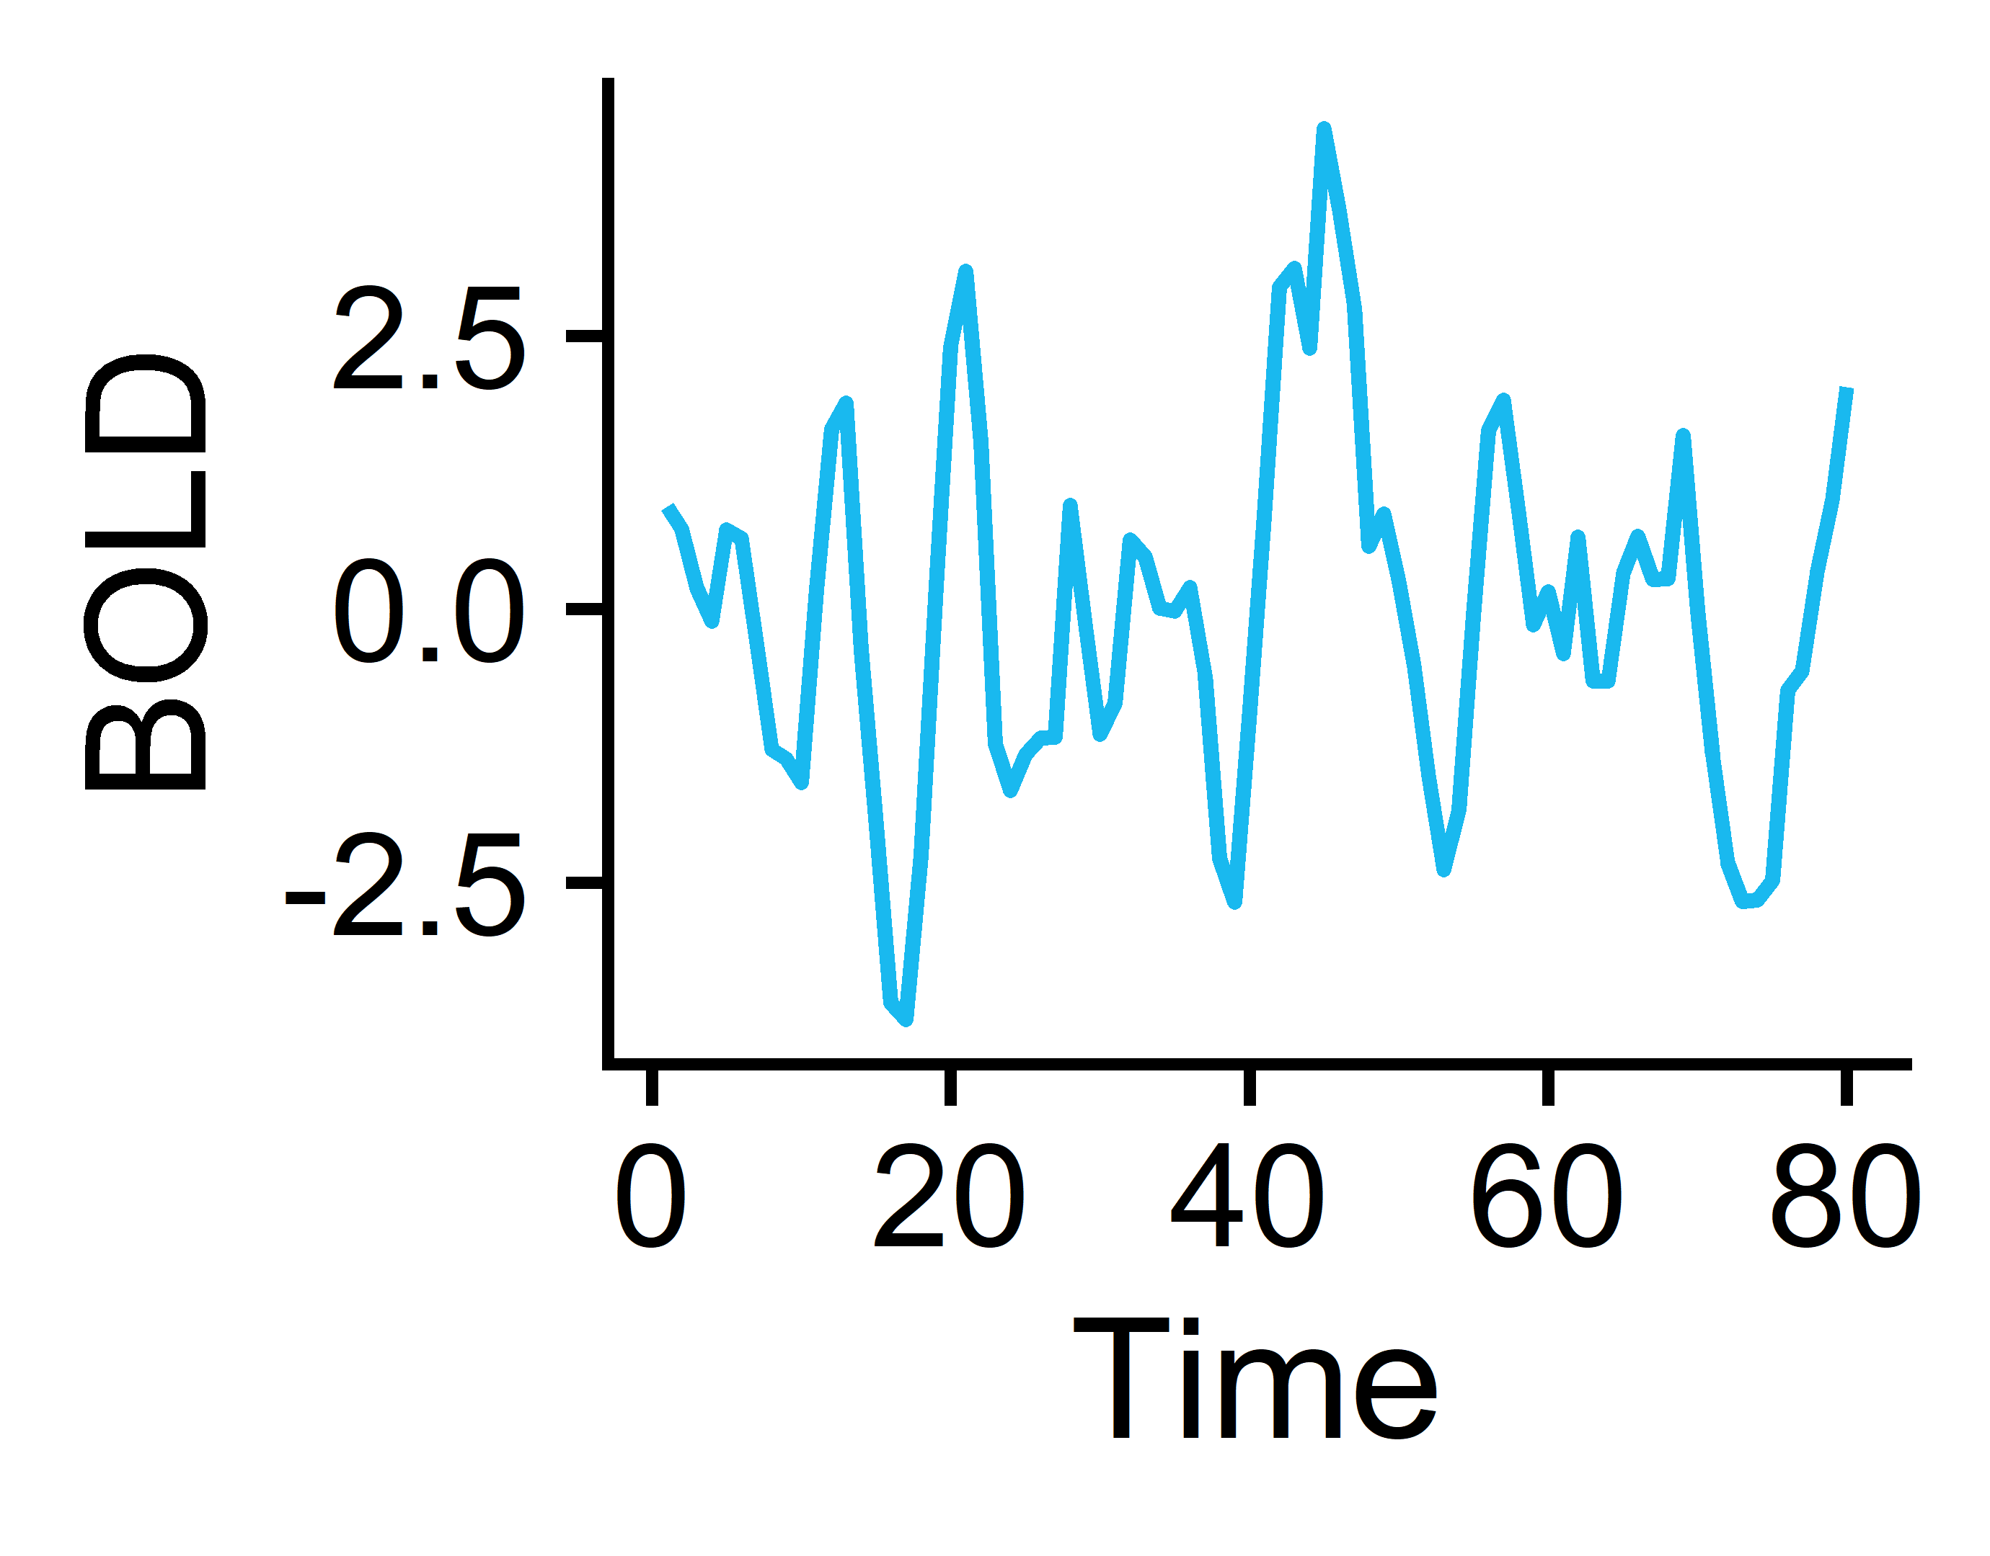
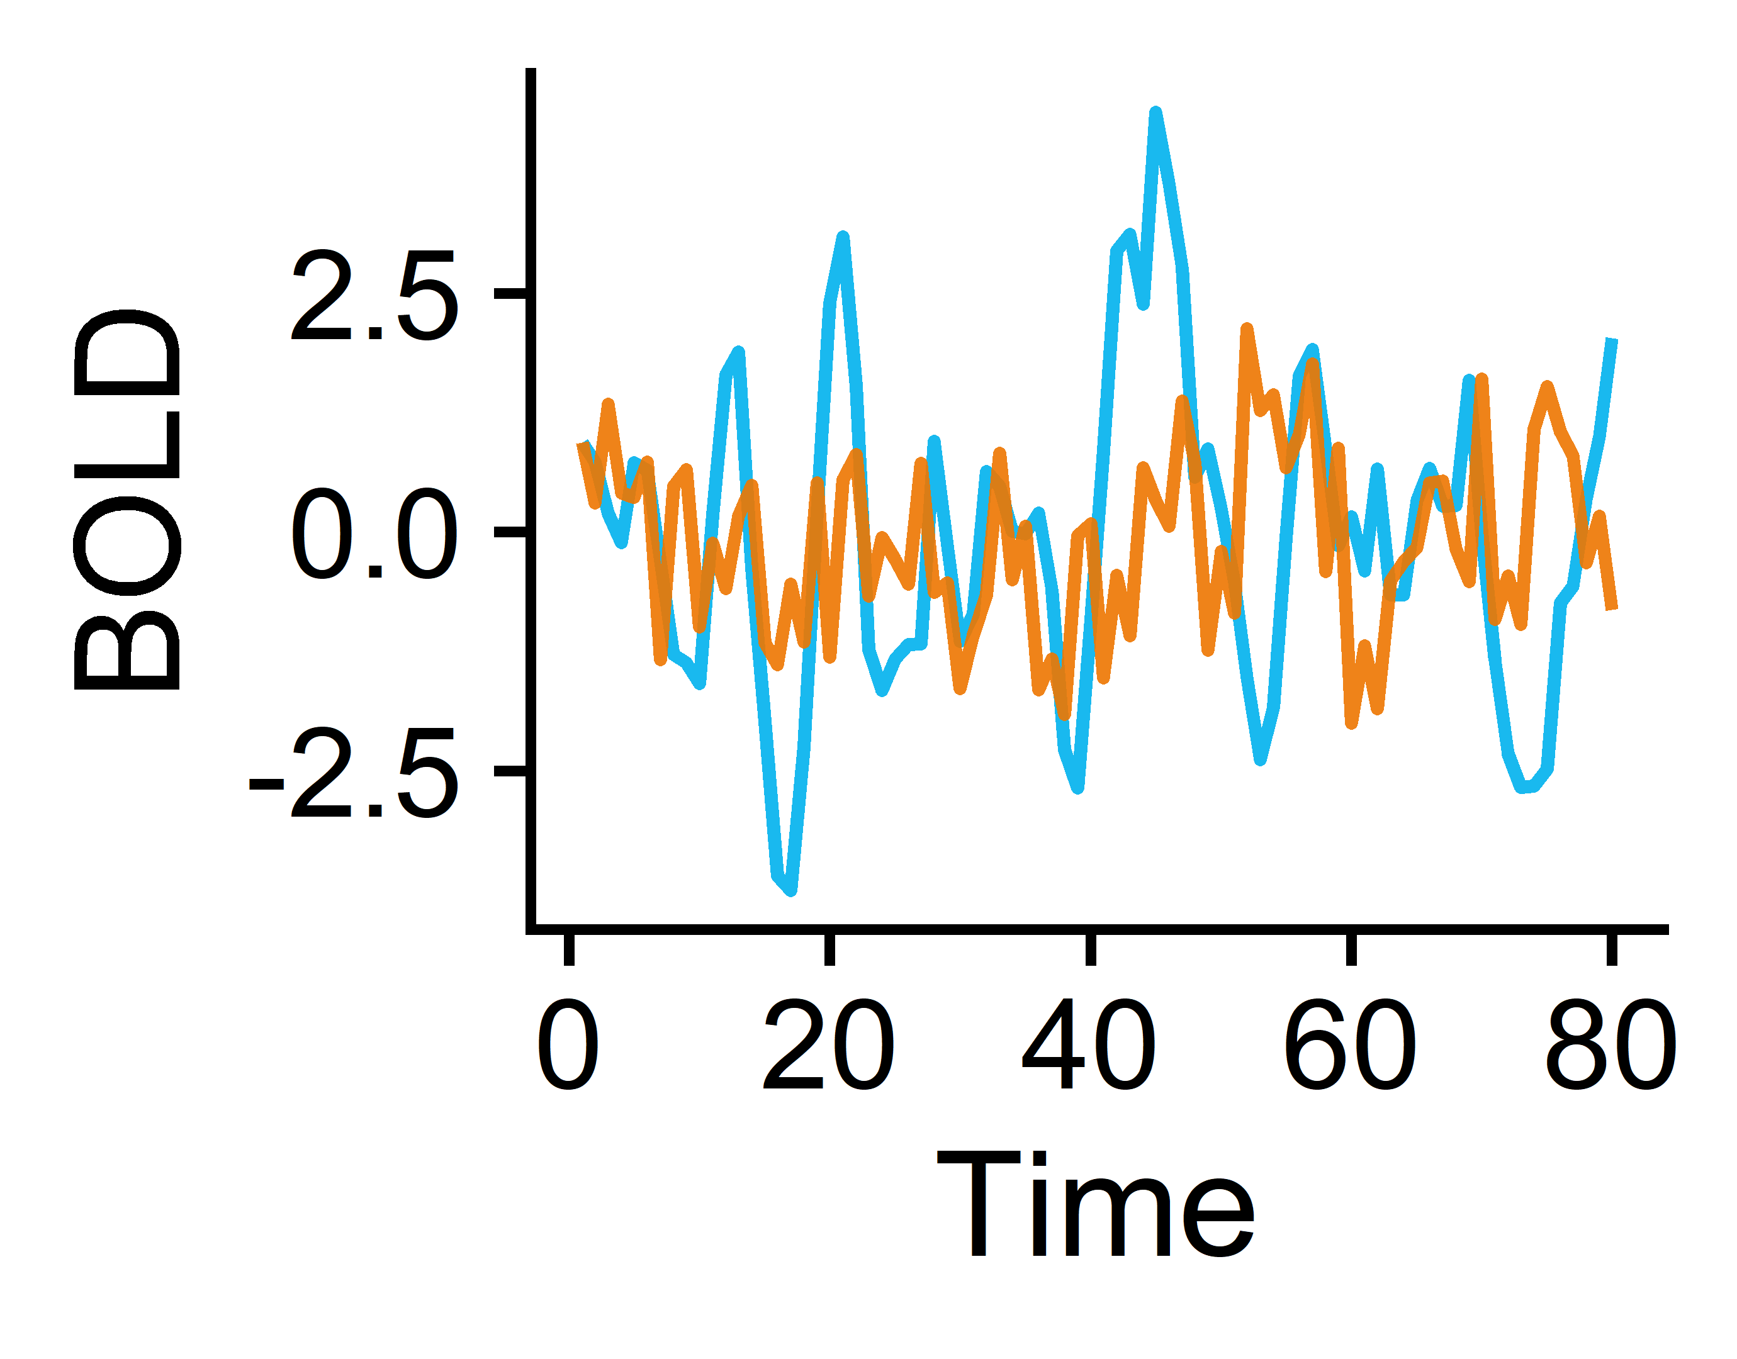
From BOLD fMRI to time-series (TS) feature matrices: a 🐤’s 👁 view
Brain
Regions 1-82
Measure BOLD temporal signals in 41 cortical + subcortical regions per hemisphere
Extract univariate TS features from each brain region
Subjects¹
Univariate features (22)
N=118 Controls
Subjects (165)
fMRI processing:
Freesurfer (structural MRI)
fmriPrep
ICA-based Automatic Removal of Motion Artifacts (AROMA)
Regress out artifacts from AROMA, signal from white matter + CSF, and signal from global gray matter (AROMA+2P+GMR)
Region pairs 1-6,632
Pairwise features (18)
N=47 with Schizophrenia
Extract pairwise TS features from each brain region pair
Subjects (165)
¹Gorgolewski KJ et al. A Preprocessed consortium for Neuropsychiatric Phenomics dataset. (2017).

Slide 7
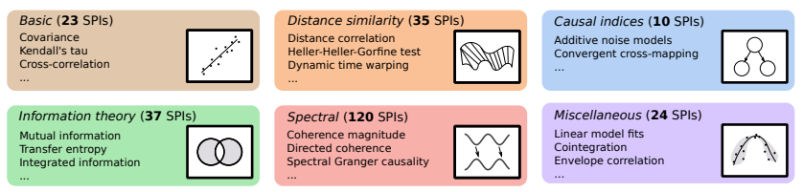




Curating time-series feature sets
Pairwise features (statistical pairwise interactions; SPIs)
Univariate features
theft
catch22
tsfel
feasts
pyspi
>1,300 features
249 SPIs
tsfresh
tsfeatures
kats
22 features derived in a data-driven manner spanning time-series properties including linear and nonlinear autocorrelation, periodicities, consecutive stretches, and simple forecasting
Semi-automatically curated subset of 18 SPIs that include dynamic time warping, spectral Granger causality, transfer entropy, and additive noise modeling
Trent Henderson
Henderson T and Fulcher BD. ICDMW (2021).
Oliver Cliff
Cliff OM et al. arXiv (2022).

Slide 8
univariate
Local regional dynamics

Slide 9
Classification method overview
Region-wise classification
Feature-wise classification
Combo-wise classification
Brain
Regions 1-82
Univariate TS features 1-22
…
TS Feature 1
TS Feature 22
Region 1
Region 82
Region 1
Region 82
Subjects (165)
Subjects (165)
…
…
Subjects (165)
Univariate features (22)
Brain regions (82)
Linear SVM by Brain Region
Linear SVM by Univariate TS feature
Linear SVM with all Region-by-Feature combinations (n=1,804)
Region 1
Region 2
Region 82
Feature 1
Feature 2
Feature 22
…
…
Goal: Identify which region(s) exhibit significantly different overall neural activity in participants with vs. without schizophrenia
Goal: Identify which univariate TS feature(s) exhibit globally altered properties in participants with vs. without schizophrenia
Goal: Identify which region(s) exhibit specifically altered individual activity dynamics in participants with vs. without schizophrenia
Note: to account for class imbalances, samples were weighted according to the inverse proportion of their class membership (Schizophrenia vs. Control) and balanced accuracy was used as the performance metric.
Notes:
Explain what balanced accuracy is

Slide 10

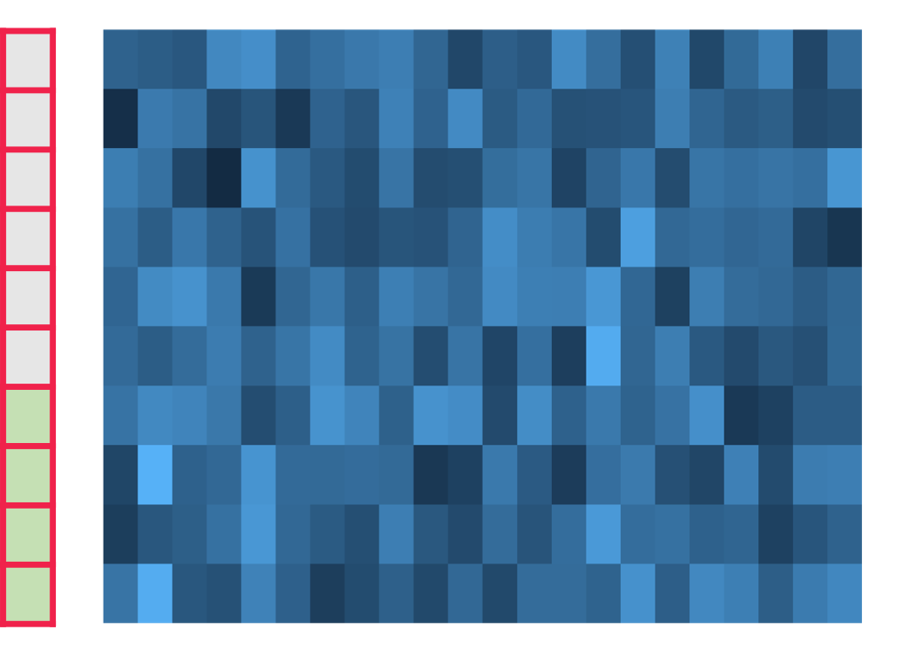
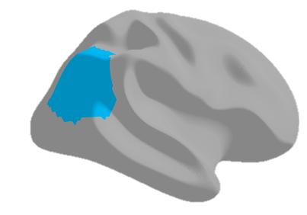
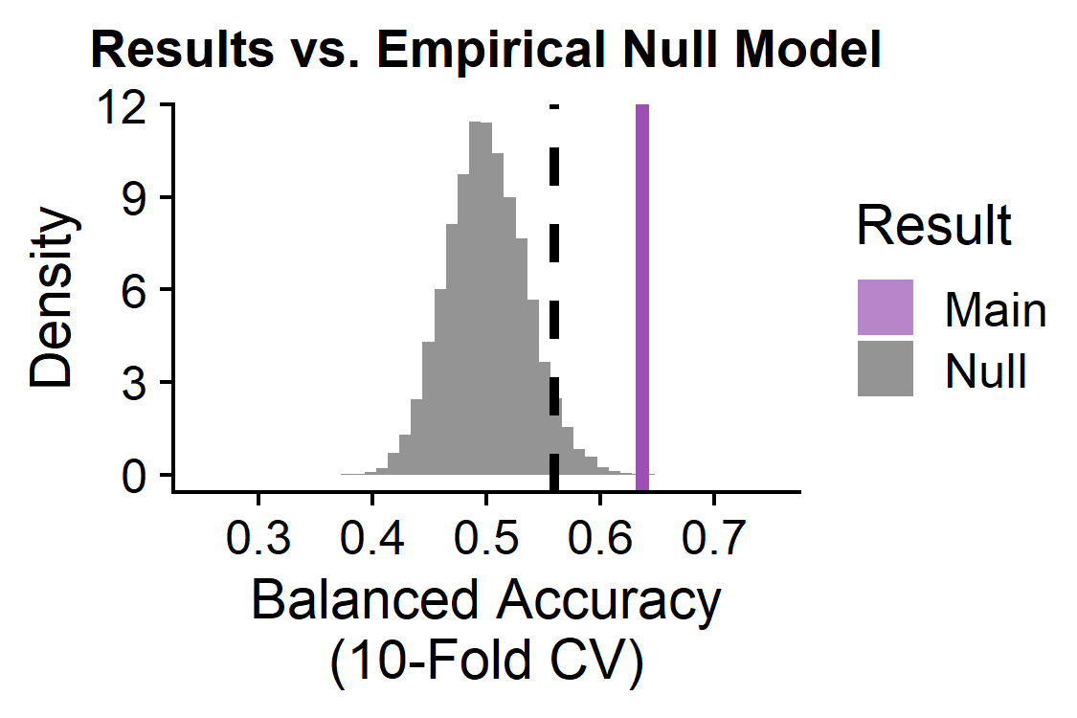
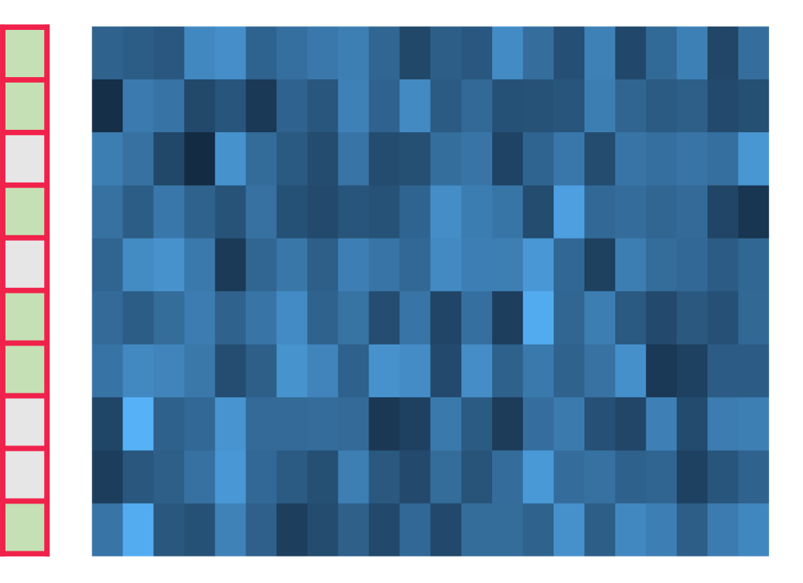
Evaluating statistical significance : pooled empirical null modeling
Linear SVM
Observed classification balanced accuracy
Group labels
Subjects (165)
Extract TS features
10-fold CV
Example region: right inferior parietal cortex
catch22 features
Shuffle group labels
Repeat 1,000X per brain region
Null permutation classification balanced accuracy
Group labels
Subjects (165)
Linear SVM
10-fold CV
p-value = # null iterations with balanced accuracy greater than the actual result
catch22 features

Slide 11
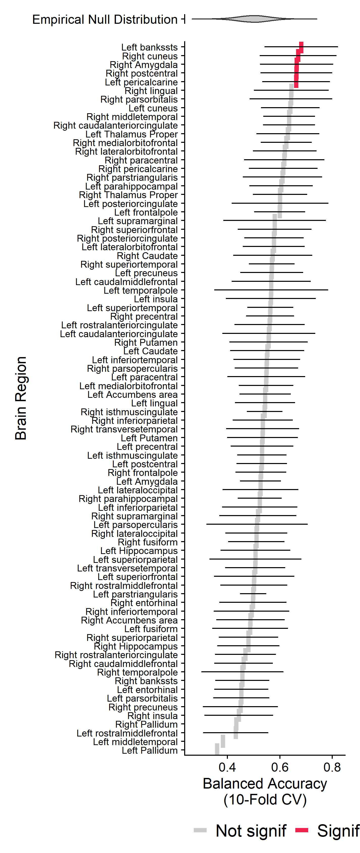
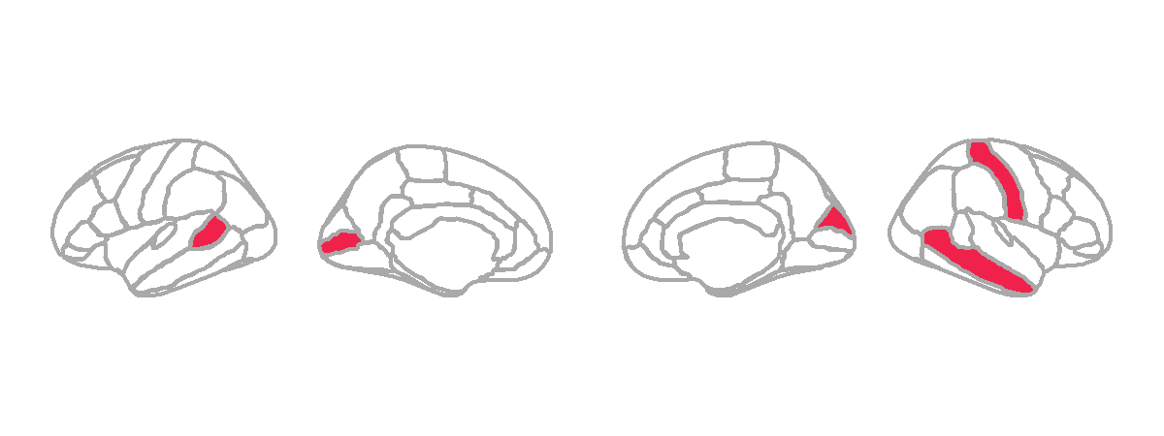
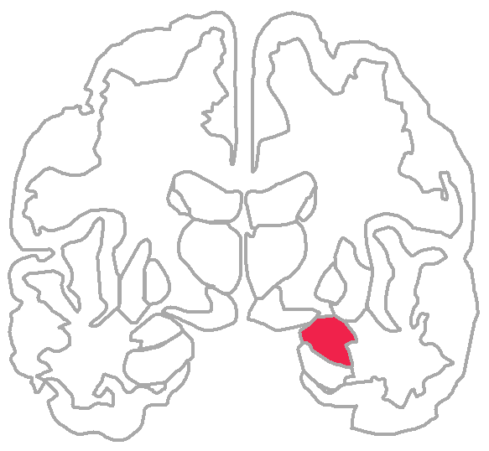
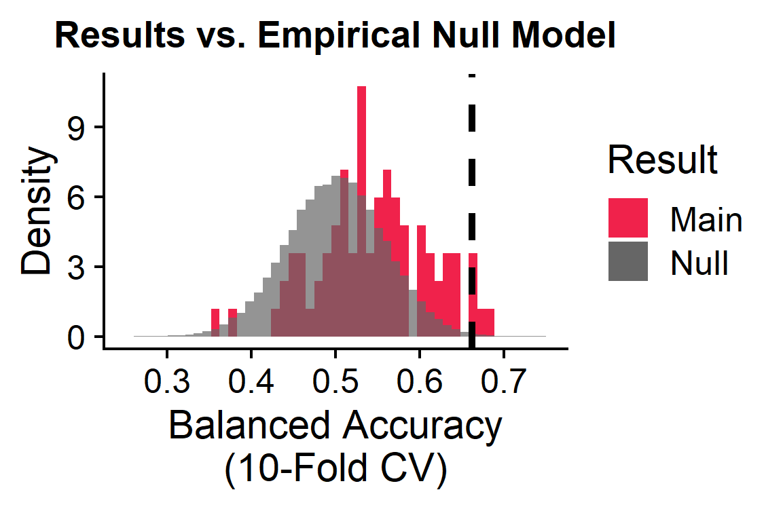
Five brain regions show altered temporal dynamics in schizophrenia
Left
Brain
Regions 1-82
L
R
L
2
1
4
Subjects (165)
3
5
Univariate features (22)
Right
5/82 brain regions significant:
L banks of the superior temporal sulcus
L pericalcarine
R cuneus
R postcentral
R amygdala
BH-adjusted p<0.05
Notes:
Banks STS in schizophrenia: https://www.frontiersin.org/articles/10.3389/fpsyg.2018.00578/full, https://pubmed.ncbi.nlm.nih.gov/23956120/

Slide 12
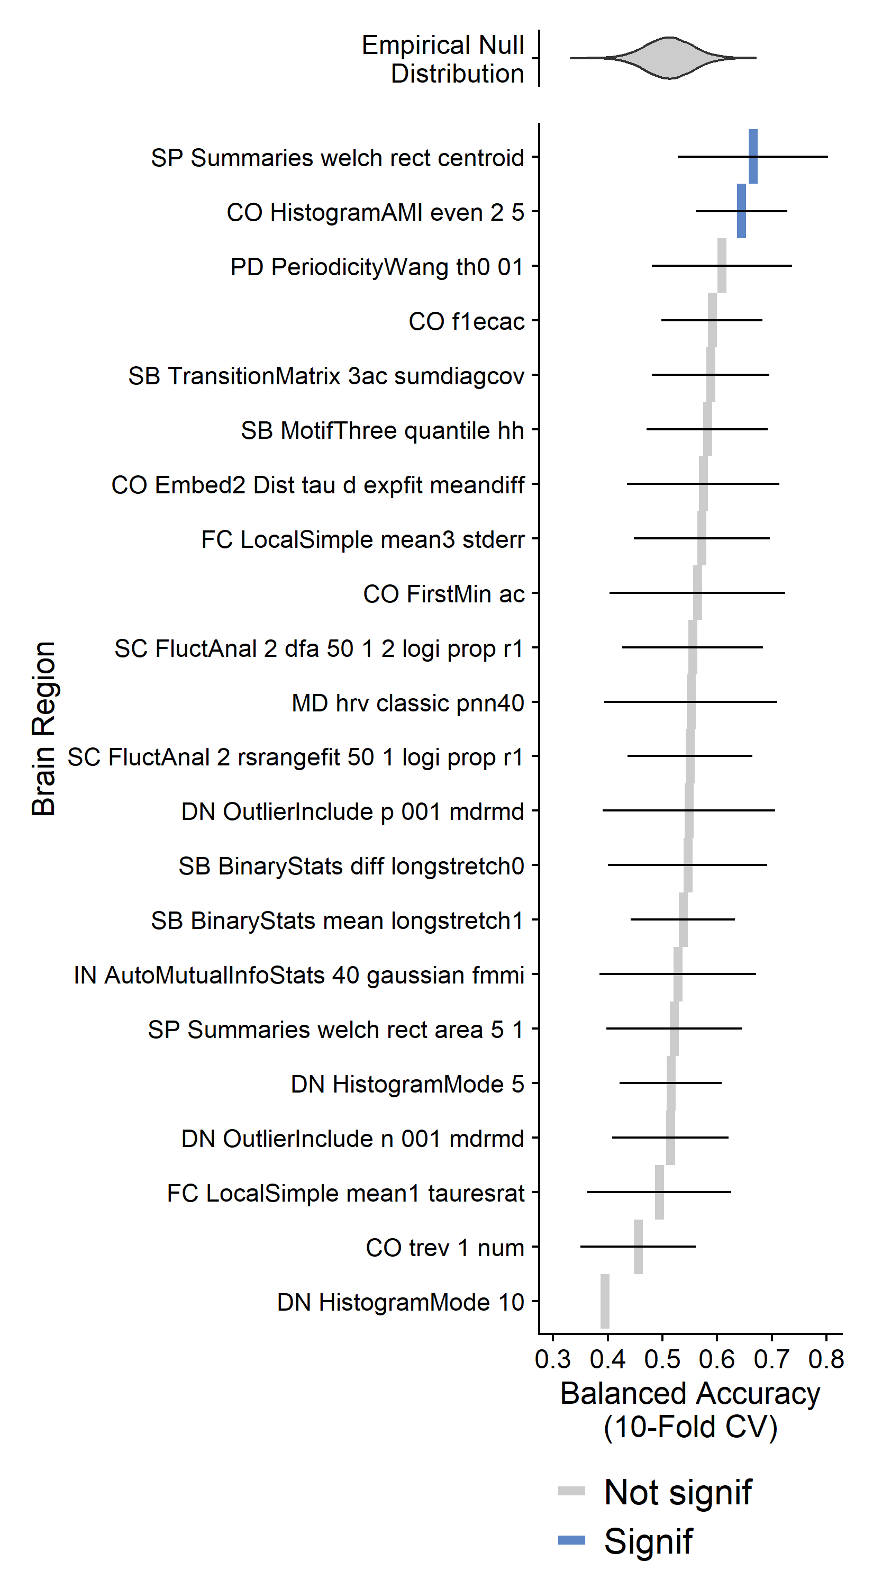
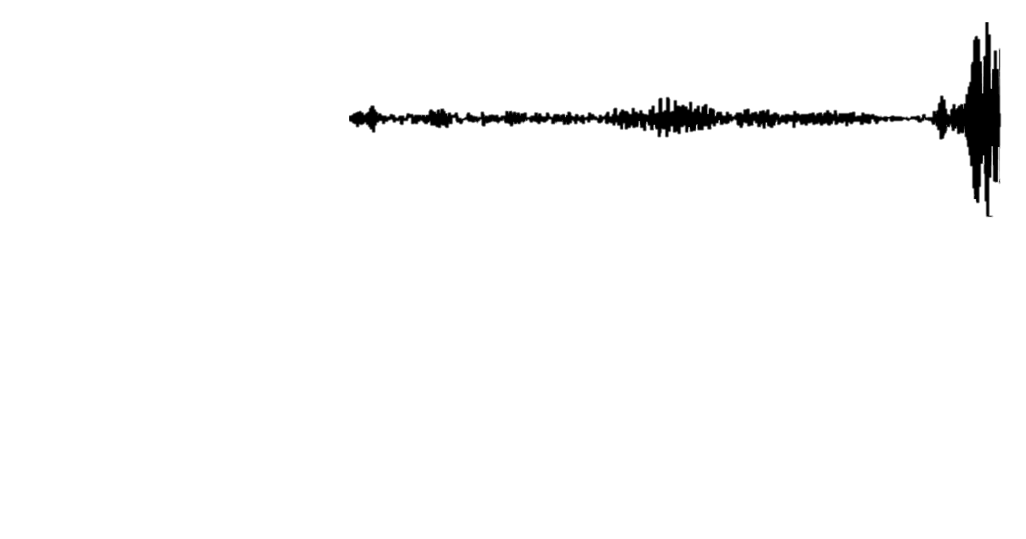
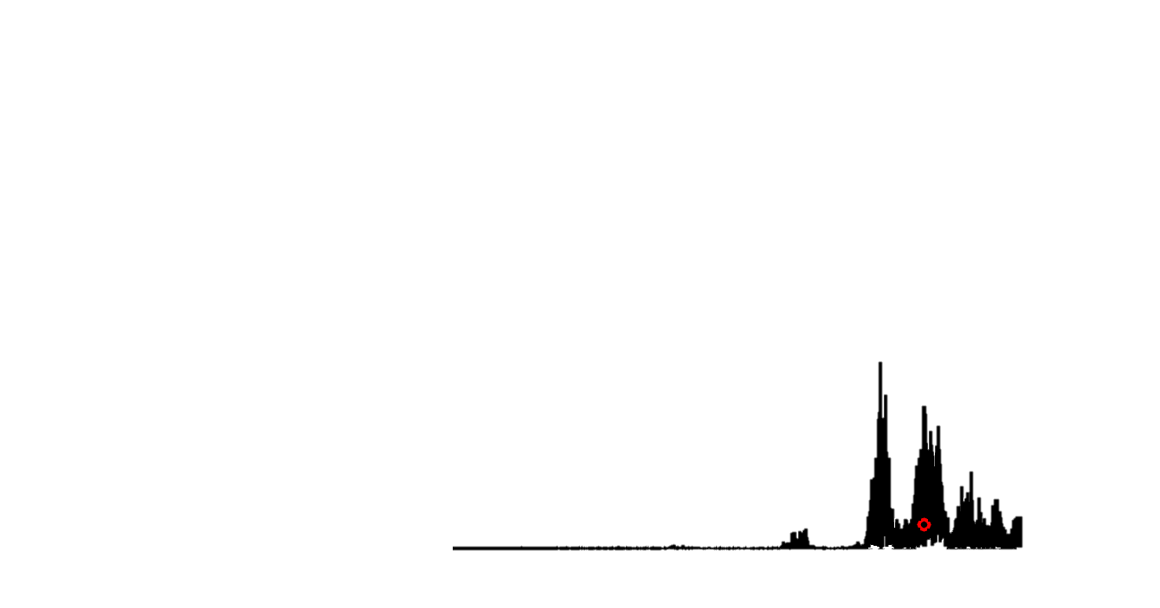
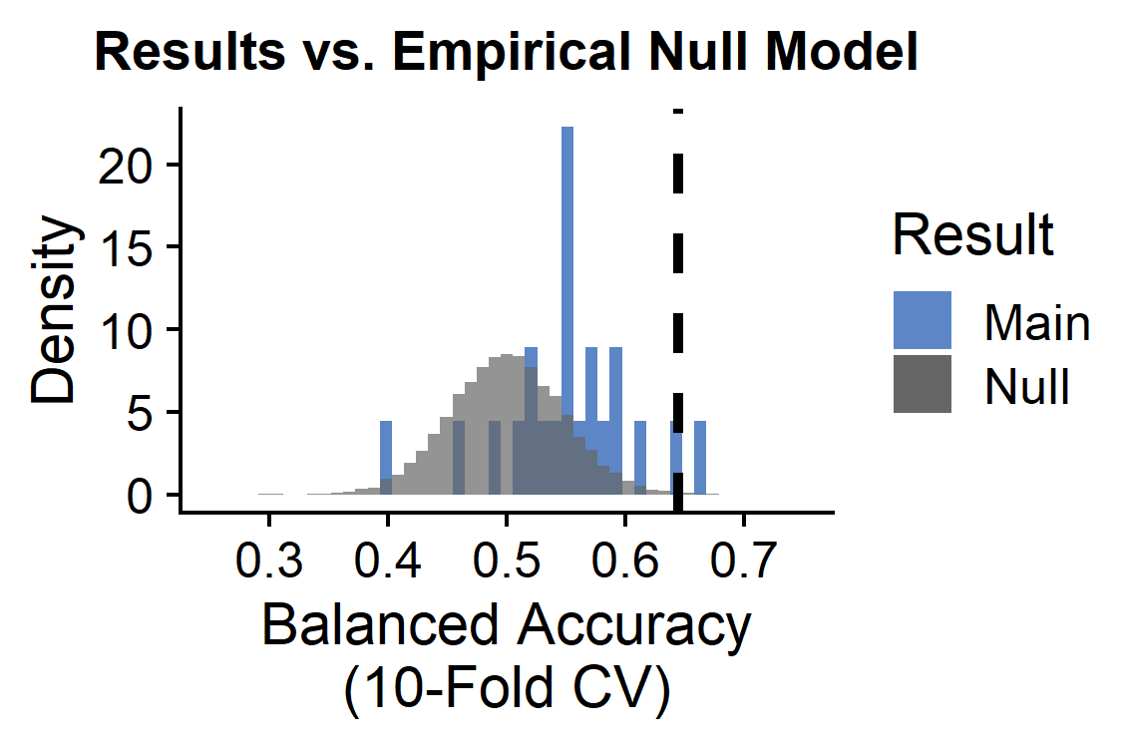
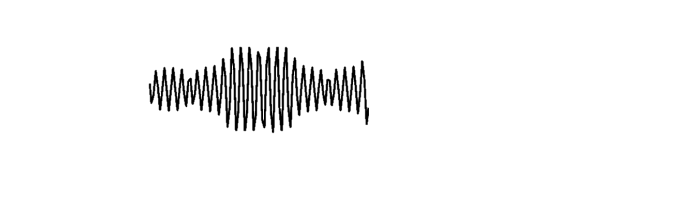
Two TS features show globally altered properties in schizophrenia
Univariate TS features 1-22
2/22 univariate TS features significant:
TS
Subjects (165)
PSD
Brain regions (82)
SP_Summaries_welch_rect_centroid: Centroid of the Welch-estimated power spectral density (PSD)
BH-adjusted p<0.05
CO_HistogramAMI_even_2_5: Nonlinear autocorrelation function with bins of 5 at lag τ = 2
Notes:
Banks STS in schizophrenia: https://www.frontiersin.org/articles/10.3389/fpsyg.2018.00578/full, https://pubmed.ncbi.nlm.nih.gov/23956120/

Slide 13
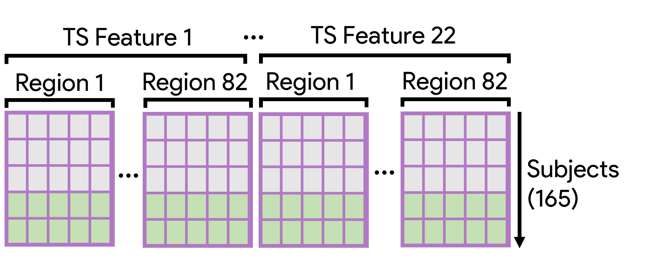
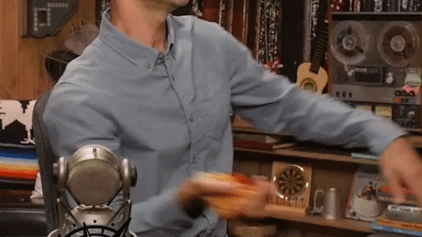
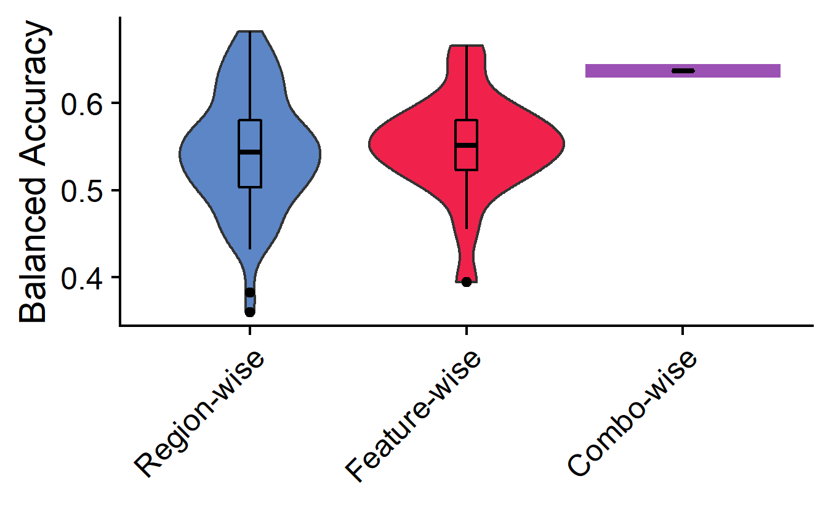
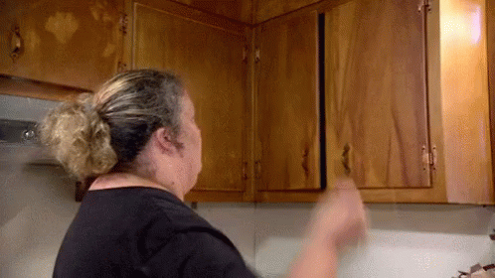
The combination of brain region X time-series dynamics
Balanced accuracy = 64%
(p ≈ 1 × 10⁻⁵)
Combo-wise linear SVM yields balanced accuracy higher than 90% (74/82) of individual brain regions and 90% (20/22) of individual univariate TS features

Slide 14
pairwise
Pairwise functional connectivity dynamics

Slide 15
Univariate + pairwise statistics coming together
SPI-wise classification
Pairwise features + univariate features classification
SPIs 1-18
SPIs 1-18
+
Subjects (165)
Subjects (165)
Brain region pairs (6,632)
Brain region pairs (6,632)
Linear SVM by SPI
Linear SVM by SPI with all Region-by-Feature combinations (1,804)
SPI 1
SPI 2
SPI 18
SPI 1
SPI 2
SPI 18
…
…
Goal: Identify which set(s) of pairwise interactions exhibit significantly different brain-wide dynamics in participants with vs. without schizophrenia
Goal: Identify which set(s) of pairwise interactions exhibit improved classification performance with the addition of univariate region-by-TS-feature data
Note: to account for class imbalances, samples were weighted according to the inverse proportion of their class membership (Schizophrenia vs. Control) and balanced accuracy was used as the performance metric.

Slide 16
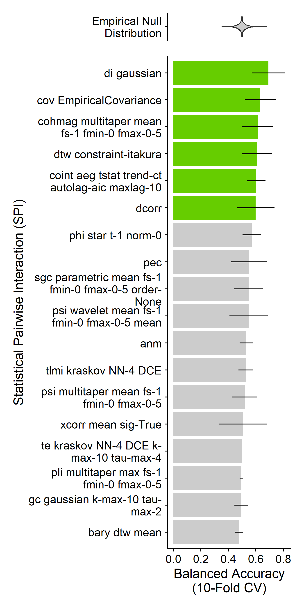
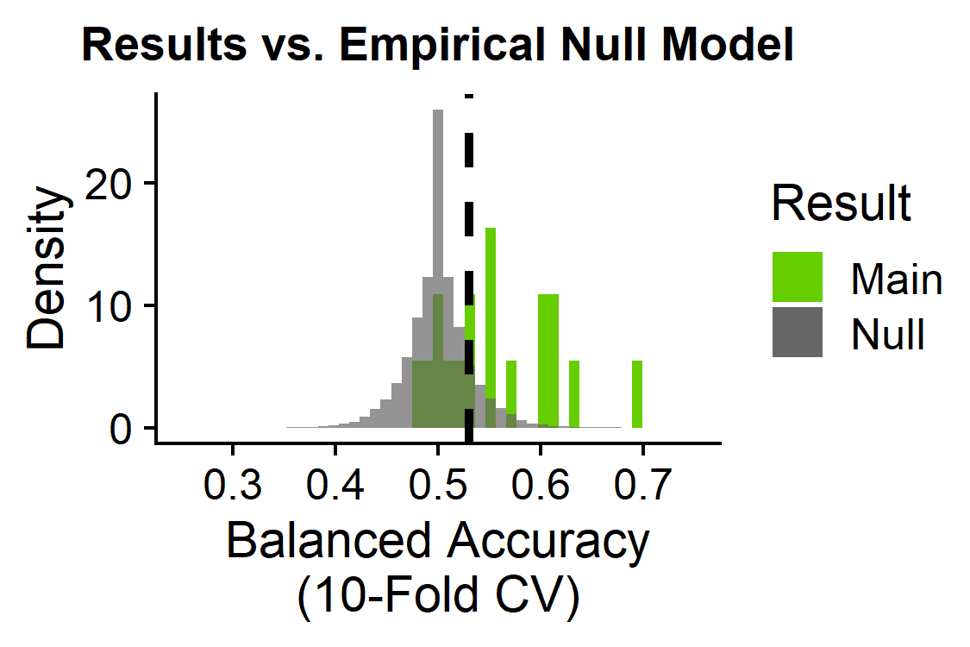
Six pairwise temporal dynamics are globally altered in schizophrenia
6/18 statistical pairwise interactions significant:
SPIs 1-18
Basic statistics
cov_EmpiricalCovariance: Pearson correlation
Information theory
di_gaussian: Directed information with a Gaussian-distribution model
Spectral
cohmag_multitaper_mean_fs-1_fmin-0_fmax-0-5: Coherence magnitude for full frequency range
Distance similarity
dtw_constraint-itakura: Dynamic time warping with Itakura parallelogram constraints
dcorr: Euclidean distance correlation
Miscellaneous features
coint_aeg_tstat_trend-ct_autolag-aic_maxlag-10: cointegration with Augmented Engle-Granger two-step test with a constant and linear trend
Brain region pairs (6,632)
Subjects (165)
BH-adjusted p<0.05

Slide 17
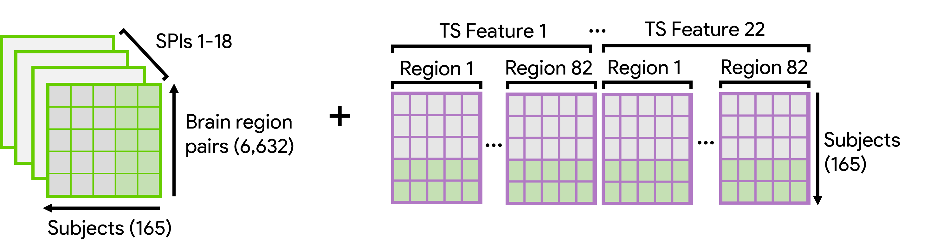
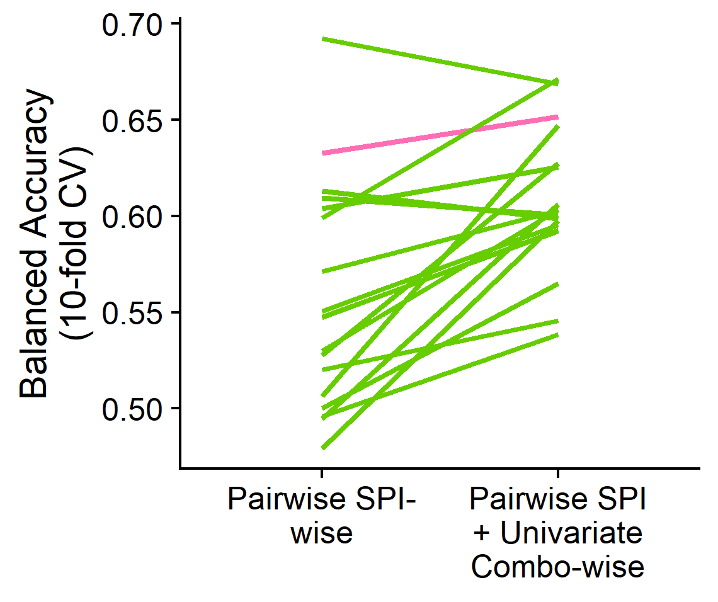
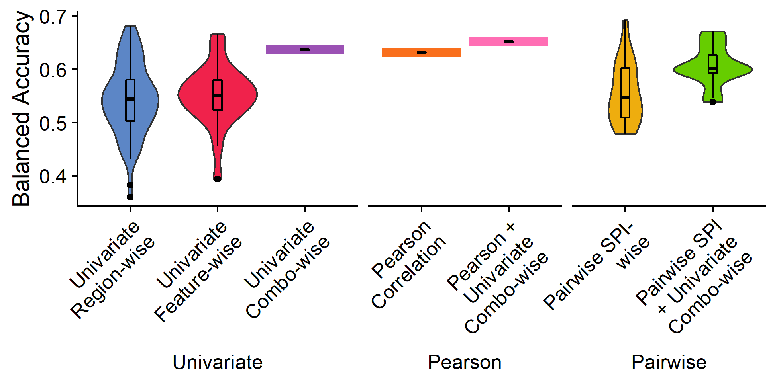
Pairwise FC features perform better with the addition of region-specific univariate TS feature info
di_gaussian
dcorr
Pearson correlation coefficient
All other SPIs
Most pairwise SPIs (incl. Pearson correlation coefficient) show improved classification balanced accuracy with the inclusion of univariate region-by-TS-feature data (mean +5%)

Slide 18
Take-🏡 messages

Slide 19
Limitations
Next Steps
Notes:
Limitations =
Next steps = dimensionality reduction to mitigate potential overfitting, feature selection to evaluate relative contribution of different regions x features, quality control, evaluate different feature subsets, apply classification model to a separate validation dataset

Slide 20
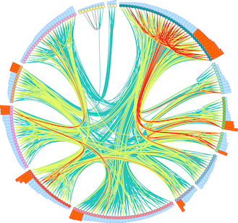




Thank you!
With support from:
Dynamics and Neural Systems Lab
School of Physics
The University of Sydney
The University of Sydney Physics Foundation
Ben D. Fulcher
Supervisor
Oliver M. Cliff
Collaborator
Trent Henderson
Collaborator
The American Australian Association Graduate Education Fund

Slide 21
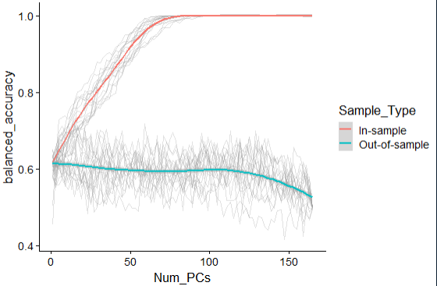
Addressing overfitting in high-dimensional space
~85 PCs sufficient to hit 100% in-sample balanced accuracy
Important question: these balanced accuracy values are still all lower than the final balanced accuracy values from the full results?
When the full set of PCs is used, there is a dropoff in out-of-sample balanced accuracy

Slide 22
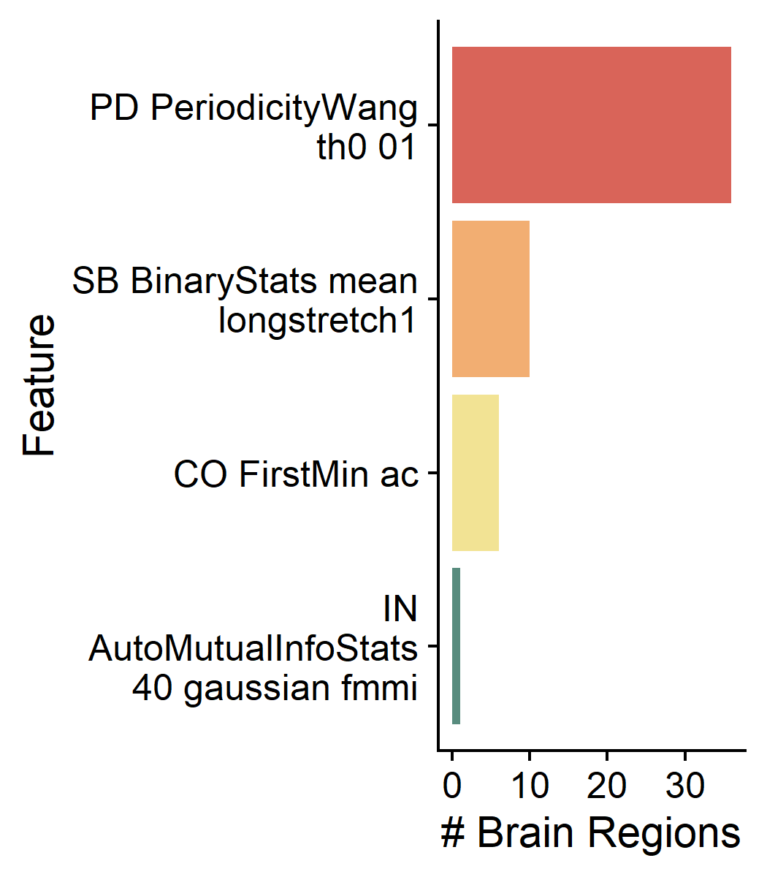
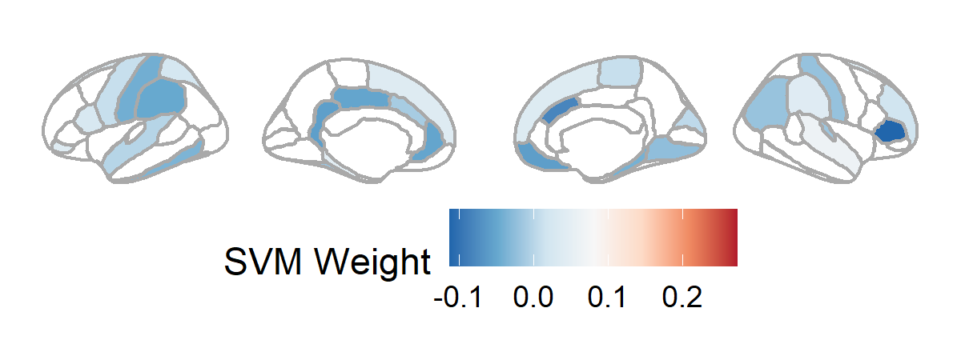
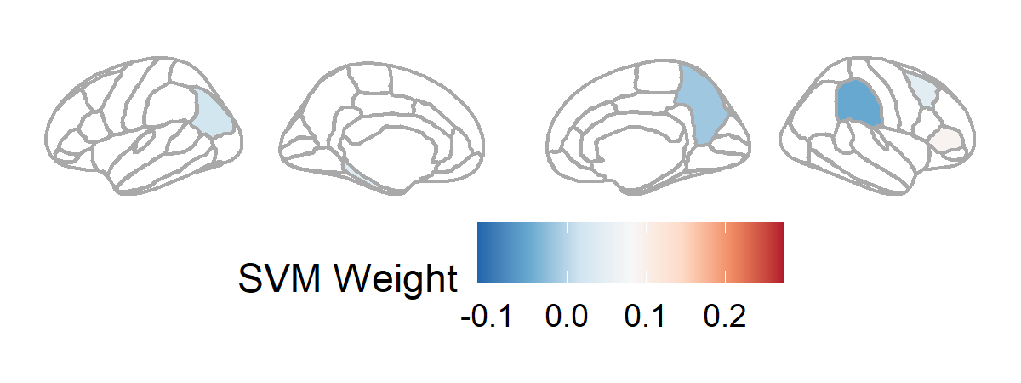
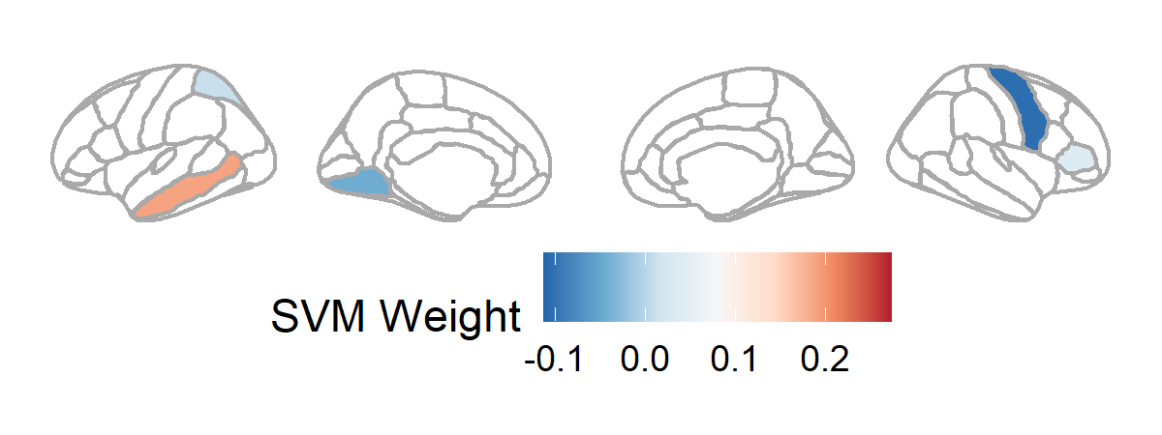
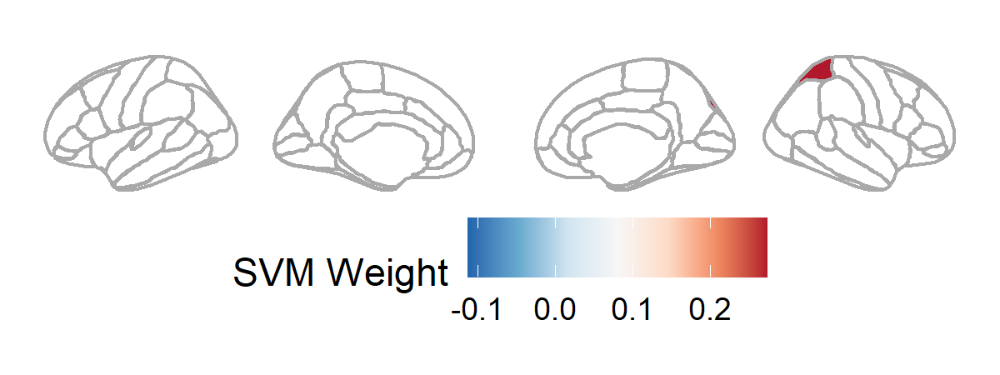
The combination of brain region X time-series dynamics
L1-regularized SVM for feature selection
Periodicity measure that is higher in slower-varying time-series
Longest sequence of consecutive time-points where value > the mean
First local minimum of the linear autocorrelation function
First local minimum of the nonlinear automutual information function
R superior temporal, R accumbens, L parahippocampal, R supramarginal, L pars orbitalis, L superior frontal, R superior frontal, L pars opercularis, L superior parietal, R rostral middle frontal, R pallidum, R temporal pole, R frontal pole, L precentral, R paracentral, R putamen, R cuneus
R pars triangularis, R fusiform, R caudal middle frontal, L parahippocampal, L temporal pole, L inferior parietal
L middle temporal, R pars triangularis, L superior parietal
R superior parietal
In-sample regularized SVM: 93.5% Bacc
Out-of-sample regularized SVM: 54.6%
R pars triangularis, R caudal anterior cingulate, R medial orbitofrontal, L isthmus cingulate, L rostral anterior cingulate, L posterior cingulate, L supramarginal, L postcentral, R parahippocampal, L inferior temporal, L frontal pole, L putamen, R lingual, R postcentral, R inferior parietal, L fusiform, R transverse temporal, L caudal anterior cingulate, L superior temporal
L frontal pole, R supramarginal, L hippocampus, R precuneus
R precentral, R pallidum, L lingual

